Slide 1
ADOPTION #6
Effectual Working

Slide 2
EPHESIANS 2 : 8 - 10
. . . Ordained unto good works . . .

Slide 3
ROMANS 4 : 13 - 16
. . . no effect . . .

Slide 4
EPHESIANS 3 : 16 - 21
. . . by His Power be strengthened . . .

Slide 5
EPHESIANS 4 : 7
. . . Unto each is given a measure . . .

Slide 6
EPHESIANS 4 : 11 - 16
. . . effectual working of each measure, edifying itself in Love . . .

Slide 7
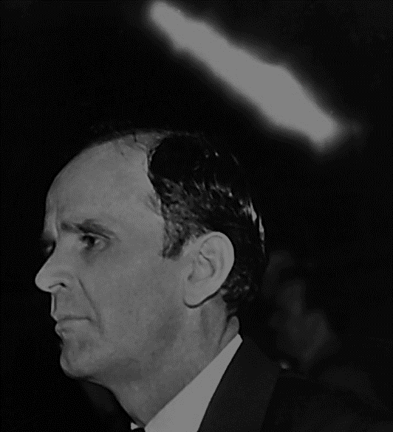
65-1125 The Invisible Union Of The Bride Of Christ
Then we’ve got the revelation in this last days, for the Message of the Lord God to gather His Bride together. No other age has it been promised. It’s promised in this age: Malachi 4, Luke 17:30, Saint John 14:12, Joel 2:38.

Slide 8
Kindergarten teacher?

Slide 9
NO! The Tutor.

Slide 10
Not the church … His Bride.

Slide 11
Supernatural power builds The Body FROM THE INSIDE His Sons & Daughters.

Slide 12
65-0117 A Paradox
… that you will just take your creeds and your beliefs, and just push them aside a few minutes, just long enough to listen to what the Scripture says, and then what God does about what He promised. And that will build faith.

Slide 13
65-0117 A Paradox
… And you won’t even need to be in a prayer line, or no one pray for you. You’re already healed, if you can just believe it. See? And that’s the purpose of it, is to let you, is to bring in conscious, to you, that what Jesus has done for you.

Slide 14
65-0117 A Paradox
It isn’t necessary to come up here and kneel down, and pray through, until you’re saved. You’re saved already, but you have to accept it. Your praying doesn’t do it. …

Slide 15
65-0117 A Paradox
… Your faith is what you’re saved by, not by prayer. But, “By faith are you saved.” Same thing by healing. I’m sure we all understand that.

Slide 16
63-0825E Perfect Faith
Now, faith is the substance, and by it, we understand, all of those things are done. It’s not a imagination, it is a substance; especially Perfect Faith. That’s what I’m talking on tonight, getting to Perfect Faith. It is not an imagination.

Slide 17
63-0825E Perfect Faith
Now, others, have people come say, “Oh, I got all faith; oh, I sure have.” Well, what are you standing here for, then?

Slide 18
63-0825E Perfect Faith
… See, your very actions prove that you haven’t got what you’re talking about. If you had faith, then what you stand in the prayer line for? What do you do these things for?

Slide 19
63-0825E Perfect Faith
See, if you had Perfect Faith, you’d look right straight to God and believe it, and walk away. You would have no need of coming into a prayer line.

Slide 20
63-0825E Perfect Faith
… You’d have no need of these things, because your faith has done made it so. What would be the use for me saying, “I got to put a shirt on”? I got a shirt on!

Slide 21
60-0313 Hear Ye Him
Now, today if we try to take the Church before God under just common church creed or theology, that’s not the way Jesus took the Church before the Father. God wants the Church to be filled with the Holy Ghost, doing the same works that He did when He was here on earth. That’s the kind of Church that the Teacher, the Holy Spirit, will want to present before God.

Slide 22
60-0313 Hear Ye Him
As I told you one time here, the contract that, in the Old Testament, when it was wrote out and then tore apart, when they come together, it had to dovetail, each piece of paper had to fit right in, and the whole program had to line up right. God confirmed His covenant with the people through Isaac to Christ, and at Calvary He tore the Messiah apart. …

Slide 23
60-0313 Hear Ye Him
… He took the body and set it on His right side, and sent the Spirit down here upon the Church. And the Church will have to have the same Spirit, doing the same things that Jesus did, or It’ll never go in the Rapture. Dovetailing.

Slide 24
60-0313 Hear Ye Him
Take this piece of paper here and tear it apart. [Brother Branham tears a piece of paper—Ed.] Now, you couldn’t impersonate it if you had to. It’s got to come back the same paper, so them letters will come just exactly like they were. That’s exactly the way the Church has got to be. …

Slide 25
60-0313 Hear Ye Him
… Jesus was always about the Father’s business, doing that which was right in His sight, not just about doing this and that, what the church becomes to do, but It is about the Father’s business, and Jesus had the testimony, “I always do that which pleases the Father.”

Slide 26
60-0313 Hear Ye Him
Then that child, God had to raise up another child. And if Pentecost fails God, God is able of these stones to rise children unto Abraham. God can call It from the Lutheran, from the Baptists, from the Presbyterians, God is able of these stones to rise children to Abraham. Somebody is going to see the vision
and take it on.

Slide 27
60-0313 Hear Ye Him
Now, if that child then did not obey, was not about the Father’s business, God would, could raise Him up another son. That’s what He’s done through the ages, raising up a Luther, raising up a Methodist, raising up a Nazarene, raising up a Pilgrim Holiness, raising up a Pentecost, He’ll keep on raising, and raising, and raising until He gets one. Hallelujah!

Slide 28
60-0313 Hear Ye Him
God, I hope to live to see that Church when She rises in the power and the beauty of the resurrection, with the powers of God working through Her, signs and wonders following the believers like it did in the New Testament. God in His power and in His might! Oh, how wonderful!

Slide 29
60-0313 Hear Ye Him
Then if this Church did obey, how the Tutor liked to come to the Father, and say, “Oh, he is just wonderful! Why You…The work is done just exactly the way You did it.” You get what I mean? “That son of Yours down there, Father, is carrying the work, Your instructions just letter by letter, the way You done it.” That’s the kind of a Church, that’s the One.

Slide 30
60-0313 Hear Ye Him
Then how the father says, “Sure proud of that son!” You know what happens? When he’s getting his schooling, his training, yet he might not be able to exercise all authority, he hasn’t got it yet, he’s still a son, but he hasn’t been placed. Now, you ministers know where I’m, what I’m getting at: placing of a son.

Slide 31
60-0313 Hear Ye Him
They had a ceremony, and then the father said, “This, my son, I adopt him, or place him positionally.” And if they had checks in those days, that son’s name on the check was just as good as his father’s name was, ’cause he was placed. And the son could fire who he wanted to, he could hire who he wanted to, he was in full possession of all the father had.

Slide 32
60-0313 Hear Ye Him
That’s the thing that God will do to His sons here on earth, someday. He’ll call you aside, Church, if you’ll only obey Him, and stay on the Word and believe it. And He’ll place into the Church, before the coming of Jesus Christ, He’ll place into the Church, all the powers that Christ had in Him will be in the Church.

Slide 33
60-0313 Hear Ye Him
All that God was, He poured into Jesus, all that Jesus was, He pours into the Church. God wanting His work done, He sent it into His Son, the Son wanting the work done, sent it into the Church. “At that day you’ll know that I’m in the Father, the Father in Me, and I in you, and you in Me.”

Slide 34
60-0313 Hear Ye Him
… At that day, because the same power of God, was in Jehovah God, rested in Jesus Christ, the same power that rested in Jesus Christ, rests in the placed sons in the Body of Christ.

Slide 35
60-0313 Hear Ye Him
Placing of a son, take him out in a certain place, have a ceremony before Angels, and place him positionally what he is in the Body of Christ, then that person has the authority.

